Slide 1
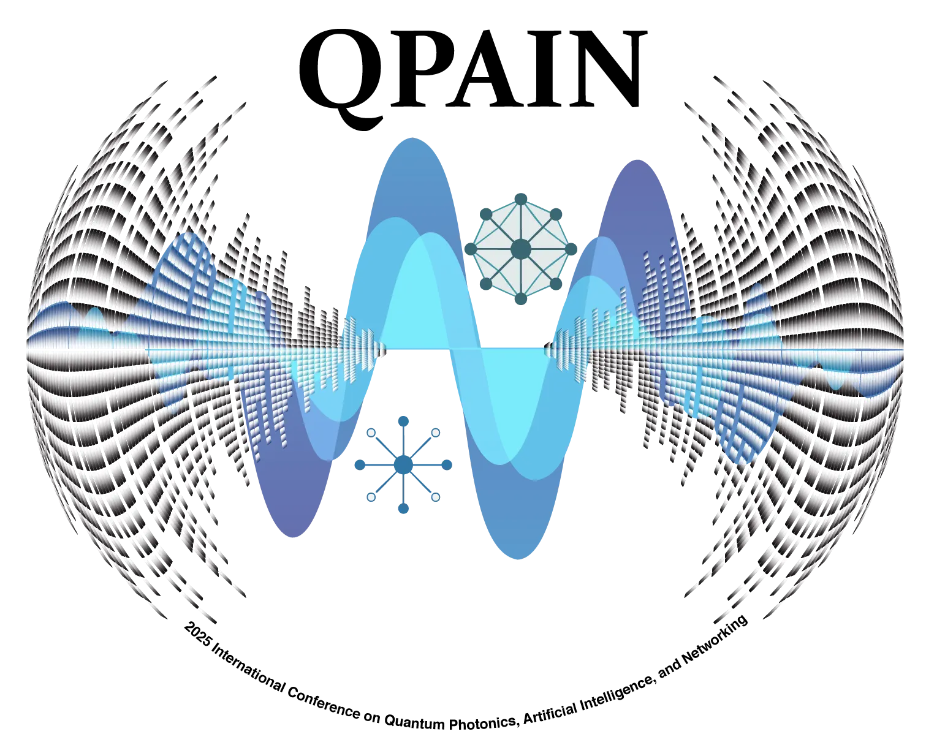

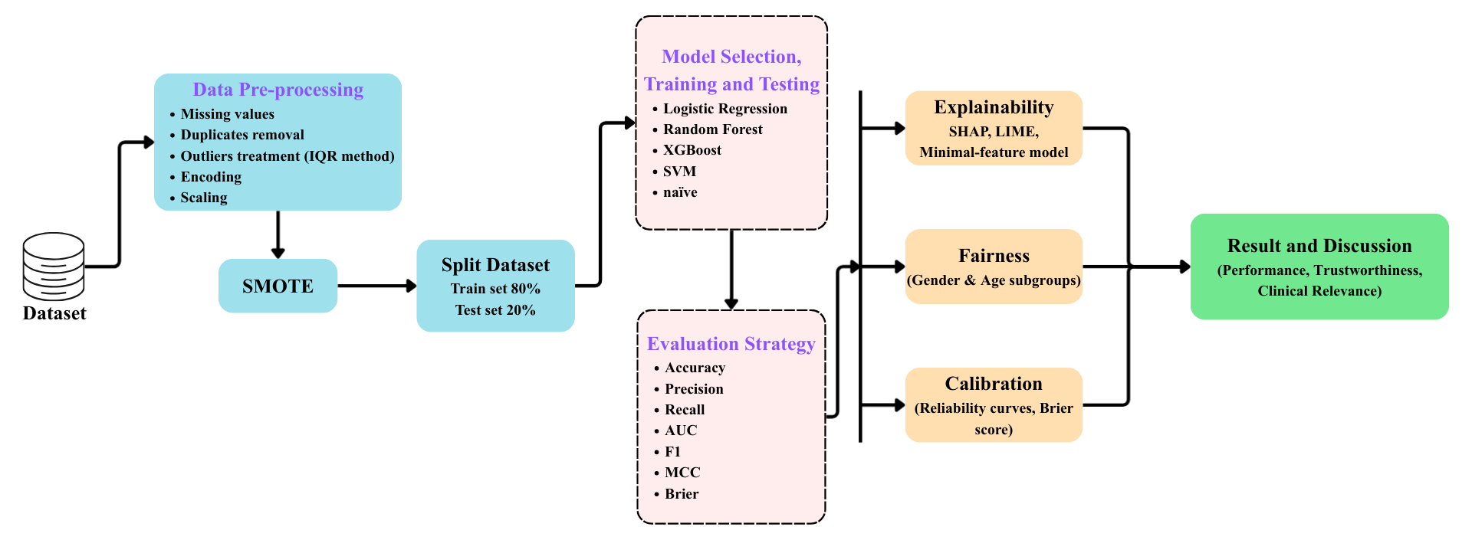
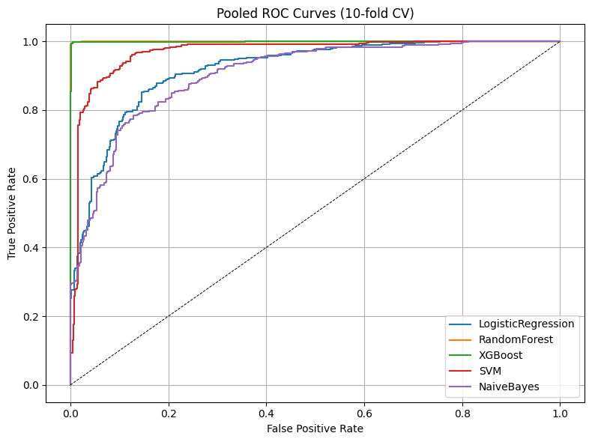
Dataset: Processed UCI Heart Disease dataset consisting of 1035 patients (69.3% male, 30.7% female).
Preprocessing: Addressed missing values, removed duplicates, handled outliers using the IQR method, encoded categorical variables, and standardized continuous features.
Balancing: Applied the Synthetic Minority Oversampling Technique (SMOTE) to the training data to fix class imbalance. * Evaluation Strategy: Used 10-fold stratified cross-validation and evaluated models based on precision, recall, F1-score, ROC-AUC, Brier score, and MCC.
Paper ID: 917
Fair and Explainable Machine Learning Framework for Heart Disease Prediction
Shuvo Sarker Joy, Swarup Biswas, Rifat Al Mamun Rudro, Kamruddin Nur
Abstract & Introduction
Methodology
Result
Heart diseases are a major global cause of mortality, causing an estimated 19.8 million deaths annually. Early detection is crucial to prevent severe health complications and save lives. While machine learning provides new ways to detect heart disease, most research focuses strictly on accuracy. Current models often overlook crucial clinical factors like fairness, probability calibration, and interpretability. This study introduces an assessment framework that addresses these gaps to develop precise, dependable, and clinically viable machine learning models.
Global Explainability (SHAP): The number of major vessels colored (ca), chest pain type (cp), ST depression (oldpeak), and maximum heart rate (thalach) were identified as the most important global predictors.
Local Explainability (LIME): Successfully clarified how predictions shifted for individual patients based on clinically meaningful attributes, adding transparency.
Conclusion & Future Work
Conclusion: The proposed framework successfully moves beyond simple accuracy, proving that models like Random Forest can combine high predictive performance (99.6% accuracy) with fairness, calibration, and interpretability for trustworthy clinical use.
Future Work: The framework should be validated on larger, multi-center prospective cohorts. Future research should also add lifestyle and genetic variables, and explore integrating these models into actual clinical decision support systems.
Dataset: Processed UCI Heart Disease dataset consisting of 1035 patients (69.3% male, 30.7% female).
Pre-processing: Addressed missing values, removed duplicates, handled outliers using the IQR method, encoded categorical variables, and standardized continuous features.
Balancing: Applied the Synthetic Minority Oversampling Technique (SMOTE) to the training data to fix class imbalance.
Evaluation Strategy: Used 10-fold stratified cross-validation and evaluated models based on precision, recall, F1-score, ROC-AUC, Brier score, and MCC.
Objectives
Comprehensive Evaluation: Compare the performance of five ML algorithms (Logistic Regression, Random Forest, XGBoost, SVM, Naïve Bayes).
Equitable AI: Analyze subgroup fairness to ensure the models do not discriminate based on sex or age.
Clinical Reliability: Utilize probability calibration curves to measure how dependable the models are for clinical use.
Interpretability: Incorporate Explainable AI (XAI) methods like SHAP and LIME to estimate and understand the most important predictive features.
Result
References
W. H. Organization, "Cardiovascular diseases (cvds)," 2021.
M. S. Singh et al., "An integrated machine learning approach for congestive heart failure prediction," Diagnostics, 2024.
I. D. Mienye and N. Jere. "Optimized ensemble learning approach with explainable ai for improved heart disease prediction," Information, 2024.
M. E. A. Sourov et al., "An explainable ai-enhanced machine learning approach for cardiovascular disease detection..." arXiv, 2025.
T. Chen and C. Guestrin, "Xgboost: A scalable tree boosting system," KDD, 2016.
Model Performance: Random Forest and XGBoost were the top-performing models, achieving near-flawless discrimination with an accuracy of 99.6% and an $AUC 0.999$.
Probability Calibration: Random Forest and XGBoost produced highly reliable probability estimates with Brier scores <0.01.
Baseline Comparison: Support Vector Machine achieved moderate accuracy (0.911), while Naïve Bayes performed the worst overall (0.822 accuracy, 0.144 Brier score).
Subgroup Fairness: Performance was largely consistent, though subgroup analysis revealed that older individuals (50 years) had slightly better accuracy than younger individuals, and males and females had a minor difference in accuracy.
2026 IEEE International Conference on Quantum Photonics, Artificial Intelligence, and Networking

